Slide 1

Mighty Marvelous Measurements
Length and Area
By: Nora and David Evans

Slide 2

Measuring Dorina

Slide 3
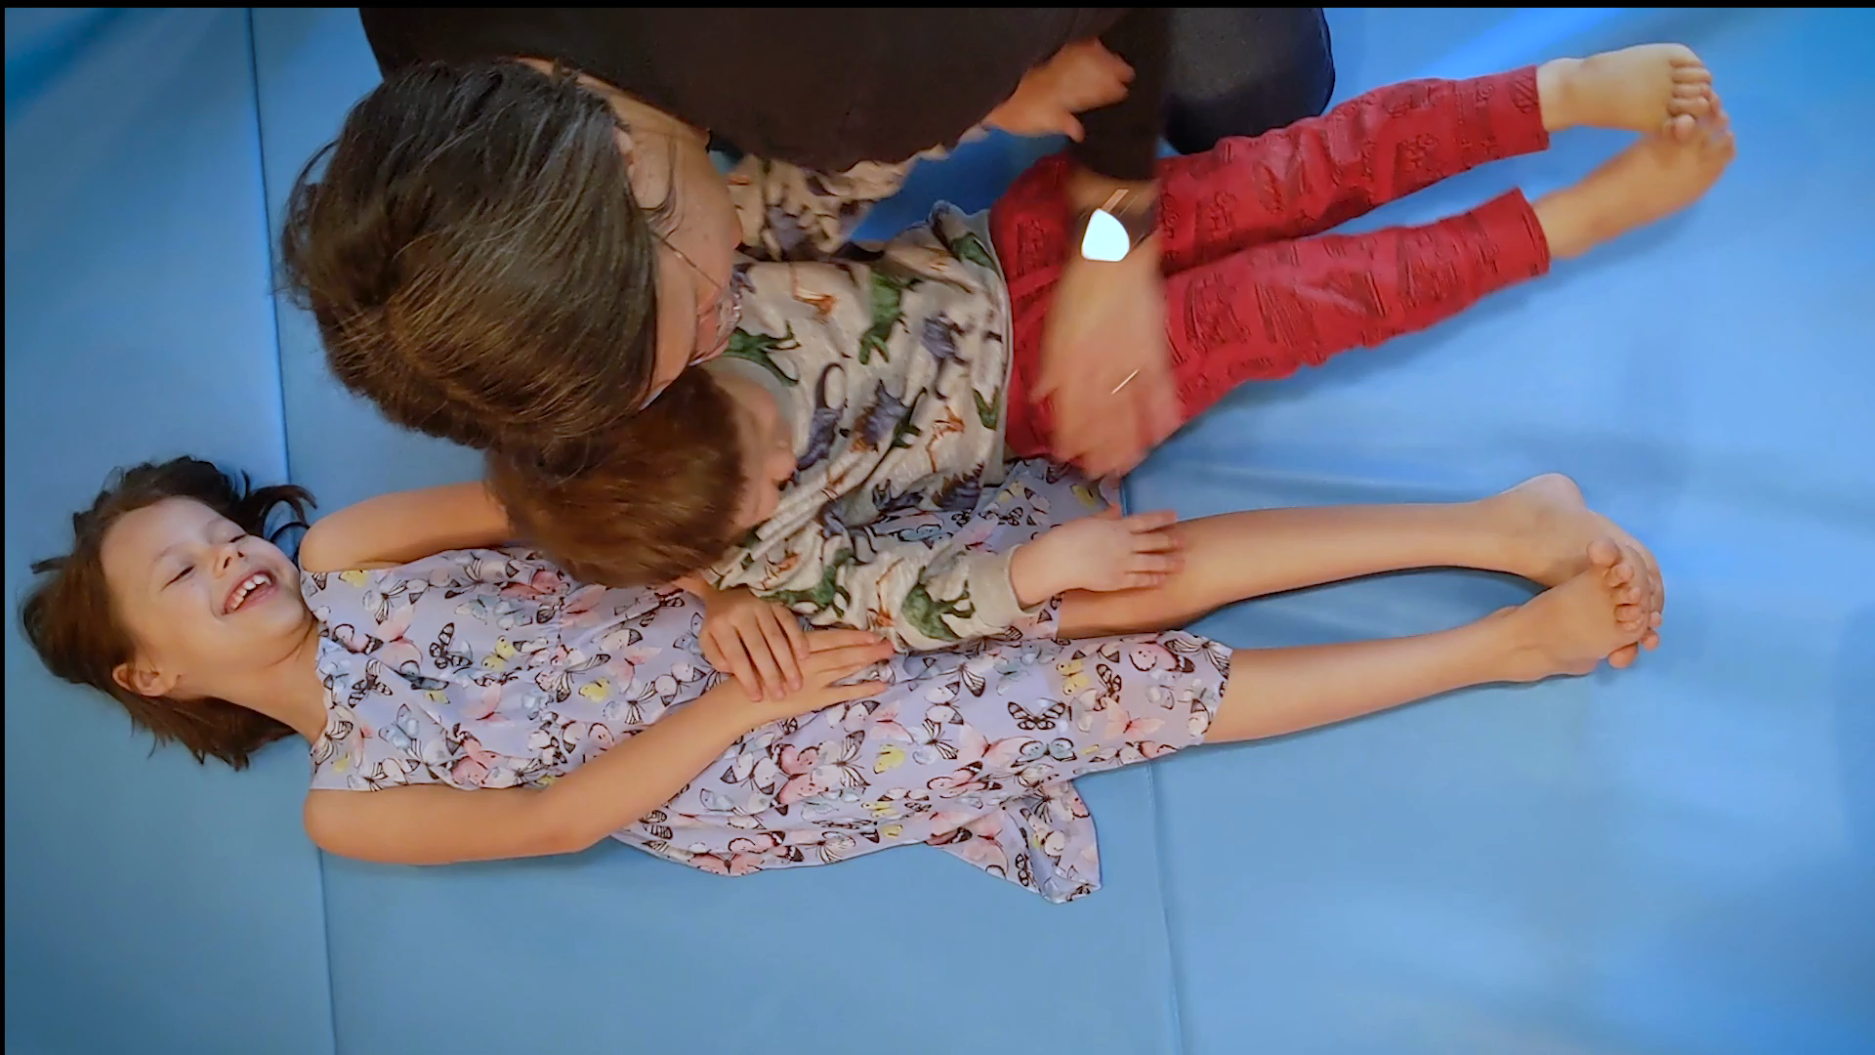
Measuring Dorina Again

Slide 4
What is the unit?
Spicey
Maxwell
Notes:
Add picture of Maxwell and Spicey

Slide 5
Distance
A number that tells you how far apart objects are.
How do we calculate that number?
First we decide on a unit of measure
Then we see how many times it “fits”

Slide 6
What about ...
We can measure the sides.
What does that tell us about the size of the shape?

Slide 7
Which one is bigger?

Slide 8
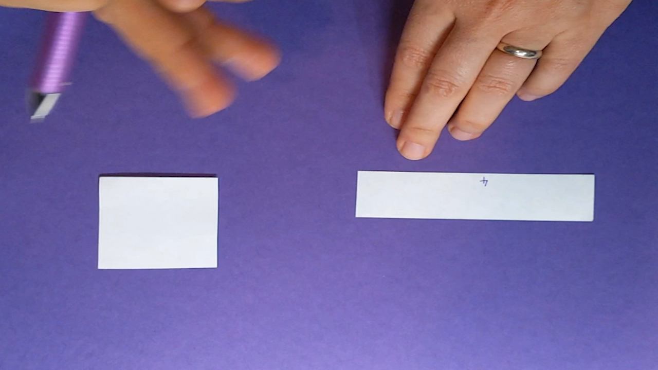
Which one is bigger?

Slide 9
Unit of Area
What shape should we use for the unit of area?
Notes:
Add a printout with graphing paper they can use

Slide 10
Shapes
Which shapes are easy to measure area using the square unit?

Slide 11
Rectangle
1 2 3 4 5 6
7 8 9 10 11 12
13 14 15 16 17 18
Notes:
What about square?

Slide 12
Rectangle
Area(rectangle) = width x length
Area = 3 units x 6 units
= 18 square units
6 units
3 units
width
length
Notes:
What about square?

Slide 13
Parallelogram
base
height
Notes:
What about rhombus?

Slide 14
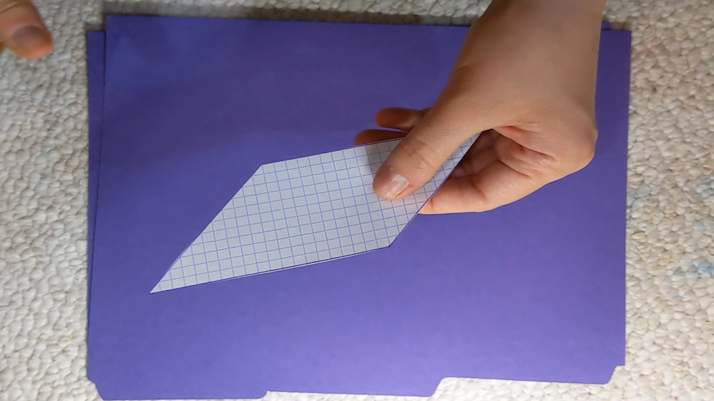
Parallelogram

Slide 15
Parallelogram
base
Area(parallelogram) = base x height
height

Slide 16
Right Triangle
height
base

Slide 17
Rectangle
Area(rectangle) = height x base
height
base

Slide 18
Right Triangle
Area(rectangle) = height x base
Area(triangle) = (height x base) ÷ 2
height
base

Slide 19
Right Triangle

Slide 20
Acute Triangle

Slide 21
Challenge
What is the triangle area formula?
Hints:
Use two right triangles
Remember the distributive property

Slide 22
Recap
Use square units for area
Area(rectangle) =
Area(parallelogram) = base x height
Area(right triangle) = (height x base) ÷ 2
Notes:
Put all formulas on the slide

